Slide 1
HTML / CSS
Week 1

Slide 2
WHOAMI?

Slide 3
IDE Review
Web Storm
Visual Studio Code
Sublime Text
Atom

Slide 4
Course Overview

Slide 5
HTML
Basic CSS
Advanced CSS

Slide 6
What is HTML?

Slide 7
Subset of SGML (“Information Processing - Text and Office System - Standard Generalized Markup Language. ISO 8879). https://www.iso.org/obp/ui/#iso:std:iso:8879:ed-1:v1:en

Slide 8
HTML

Slide 9
The next Latin?

Slide 10
No.

Slide 11

Human Communication
A common Context

Slide 12

Computers aRE Stupid
They have No context.

Slide 13
So what is the Context?

Slide 14
Let’s try an analogy…
Some Parts of Speech.

Slide 15

HTML
Nouns
CSS
adjectives
JS
Verbs

Slide 16

Person, Place, or Thing
?
HTML tells the Browser what everything is.

Slide 17
HTML provides a browser with context.

Slide 18
HTML has grown

Slide 19


4.01
5.0

Slide 20
HTML 4.01 Basic Tags
A, ABBR, ACRONYM, ADDRESS, APPLET, AREA, B, BASE, BASEFONT, BDO, BIG, BLOCKQUOTE, BODY, BR, BUTTON, CAPTION, CENTER, CITE, CODE, COL, COLGROUP, DD, DEL, DFN, DIR, DIV, DL, DT, EM, FIELDSET, FONT, FORM, FRAME, FRAMESET, H1, H2, H3, H4, H5, H6, HEAD, HR, HTML, I, IFRAME, IMG, INPUT, INS, ISINDEX, KBD, LABEL, LEGEND, LI, LINK, MAP, MENU, META, NOFRAMES, NOSCRIPT, OBJECT, OL, OPTGROUP, OPTION, P, PARAM, PRE, Q, S, SAMP, SCRIPT, SELECT, SMALL, SPAN, STRIKE, STRONG, STYLE, SUB, SUP, TABLE, TBODY, TD, TEXTAREA, TFOOT, TH, THEAD, TITLE, TR, TT, U, UL, VAR

Slide 21
HTML 5 Basic Tags
div,article, aside, bdi , details, dialog, figcaption, figure, footer, header, main, mark, menuitem, menu, meter, nav, progress, rp, rt , ruby, section, summary, time, wbr, datalist, keygen, output, canvas, svg, audio, embed,source, track, video
color, date, datetime, datetime-local, email, month, number, range, search , tel, time, url, week
autocomplete, autofocus, form, action, enctype, method, novalidate, target, height, width, list, min, max, multiple, pattern, placeholder, required, step

Slide 22
Tags surround content

Slide 23
usually.

Slide 24
Tag Structure(s)
<opening_tag> content </closing_tag>
Tag singletons:
<singleton_tag />
provide other resources or insert an element

Slide 25
singleton tags
<area />,<base />, <br />, <col />, <command />, <embed />, <hr />, <img />, <input />, <keygen />, <link />, <meta />, <param />, <source />, <track />, <wbr />

Slide 26
BUT!

Slide 27
Generally, Tags surround the content

Slide 28
Using most tags is like writing a sentence.
Start with the opening tag, like a capital letter.
End with the closing tag, like punctuation.

Slide 29
Using different types of tags provides context, & describes the content to the browser.

Slide 30
Combine tags to add more description
<p>foo bar.</p>
<p>foo <strong>bar</strong></p>

Slide 31
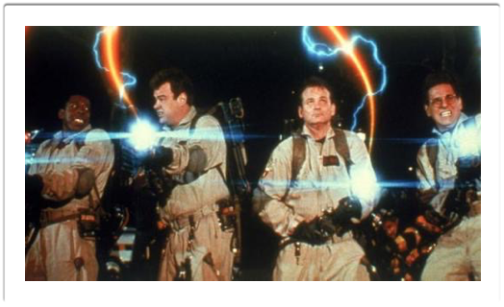
DO NOT interleave Tags
Don’t cross the streams
https://www.youtube.com/watch?v=jyaLZHiJJnE

Slide 32
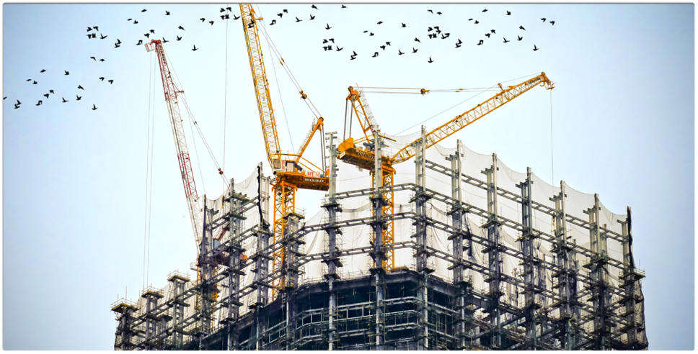
Let’s build a webpage!
One Piece at a time.

Slide 33
First: DocType

Slide 34

Doctypes
<!DOCTYPE HTML PUBLIC “-//W3C//DTD HTML 4.01 Transitional//EN” “http://www.w3.org/TR/html4/loose.dtd”>
<!DOCTYPE html>

Slide 35

Head
Describe the Description

Slide 36
“A block-level element occupies the entire space of its parent element (container), thereby creating a ‘block.’”
https://developer.mozilla.org/en-US/docs/Web/HTML/Block-level_elements

Slide 37
Block Tags
address, article, aside, blockquote, canvas, dd, div, dl, fieldset, figcaption, figure, footer, form, h1, h2, h3, h4, h5, h6, header, hgroup, hr, li, main, nav, noscript, ol, output, p, pre, section, table, tfoot, ul, video
https://developer.mozilla.org/en-US/docs/Web/HTML/Block-level_elements

Slide 38
“An inline element occupies only the space bounded by the tags that define the inline element.”
https://developer.mozilla.org/en-US/docs/Web/HTML/Inline_elements

Slide 39
inline tags
b, big, i, small, tt, abbr, acronym, cite, code, dfn, em, kbd, strong, samp, time, var, a, bdo, br, img, map, object, q, script, span, sub, sup, button, input, label, select, texture
https://developer.mozilla.org/en-US/docs/Web/HTML/Inline_elements

Slide 40
Tags for the Head
head
title
meta
link
style

Slide 41
<!DOCTYPE html>
<html>
<head>
<meta charset="utf-8">
<title> Some Page</title>
</head>
<body>
Some Content
</body>
</html>

Slide 42
<!DOCTYPE html>
<html>
<head>
<meta charset="utf-8">
<title> Some Page</title>
<link rel="stylesheet" href="/css/master.css">
<script src="script.js"></script>
</head>
<body>
Some Content
</body>
</html>

Slide 43
Practice!

